Slide 1
Chapter 7
Agriculture

Slide 2
Is Agriculture a Good Investment?
70% of the world’s population lives in rural areas
…and most of the poor
Agriculture’s shares of GDP and employment both plummet as per-capita incomes rise
Why invest in a sector that’s becoming less important all the time?

Slide 3
Countries Where Agriculture Does Not Grow Quickly Do Not Grow Quickly...
Agricultural Growth
Low
Medium
High
Per-capita Income Growth
Low
17
5
3
Medium
0
10
3
High
2
1
11
Source: Peter Timer, Handbook of Development Economics

Slide 4
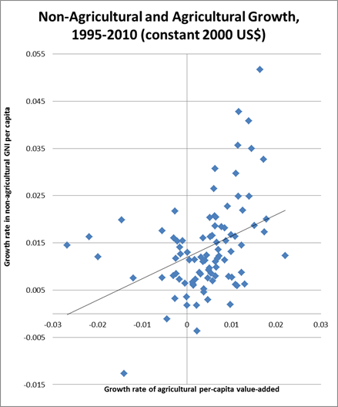
Ag and Non-ag Growth
A one percentage point increase in agricultural growth is associated with nearly a half (.45) percentage point increase in non-agricultural growth
But don’t confuse with cause-and-effect!

Slide 5
Agriculture’s Contributions
1. Source of labor for modern sector
2. Source of savings for investments
3. Source of foreign exchange through exports
4. Source of tax revenue
5. Market for manufactured goods

Slide 6
Three Kinds of Policies that Have Hurt Agriculture
Cheap food policies, taxation
  Government pays farmers below-market price
    Good for consumers, keeps wages low
    Results in too little food production, more imports
  High taxes on farmers do same
Sectoral Policies: Subsidies for industry
  Direct subsidies, cheap credit, infrastructure investment
  Make agriculture less profitable relative to industry, draw resources out of agriculture
Trade policies
  Overvalued exchange rate makes imported inputs, technology, and food cheaper
    Hurts producers of exports and importable goods (tradables)
  Import substitution (quotas, import tariffs) for manufactures makes industry more profitable relative to agriculture
  A few low-middle income (e.g., CAFTA) countries protect agriculture
    Good for commercial farmers, bad for consumers
Any of these policies can create distortions, welfare losses

Slide 7
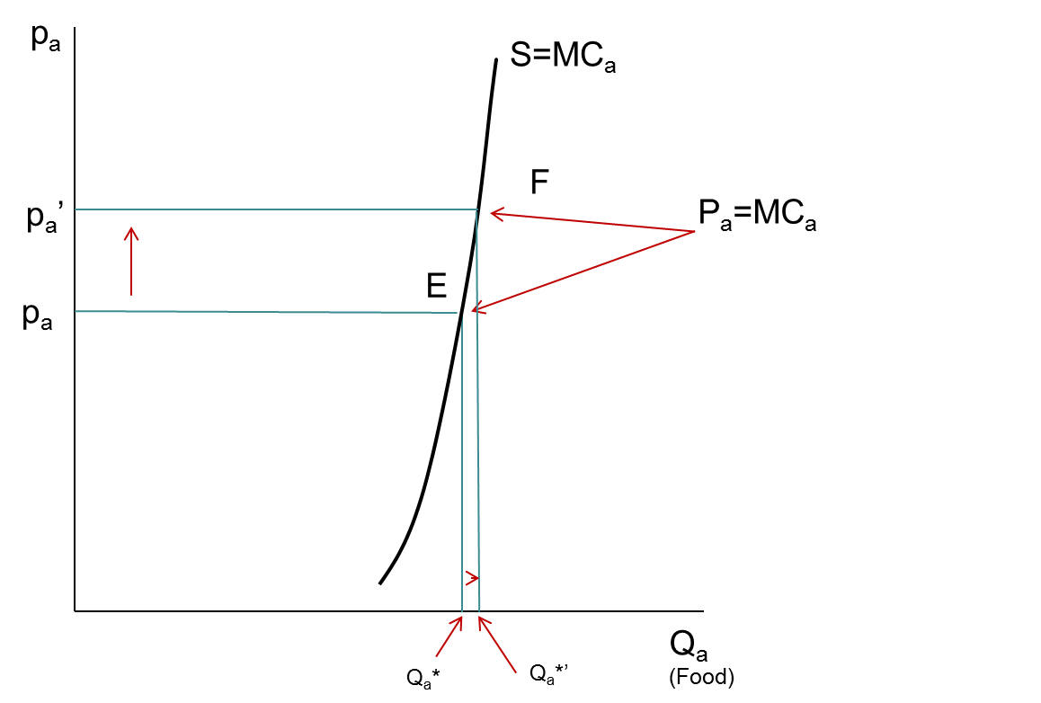
Technology Matters!
(Traditional agriculture’s inelastic supply response)

Slide 8
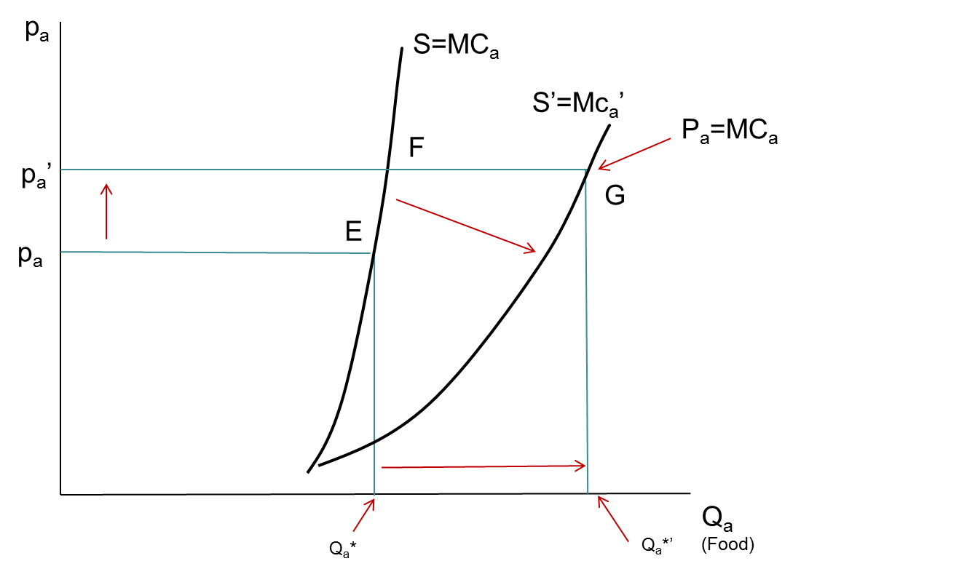
Technological Change Can Shift Out, Flatten the S Curve

Slide 9
Increasing the Supply Response
Requires technological change
  Focus on the constraints
  Mechanical packages (labor-saving)
  Biological package (land-saving)
Benefits: Raise farm incomes, make food cheaper
How? R&D, extension, credit, market development

Slide 10
Why Agriculture Is Different
Nature as input
Uncertainty, timing
Many producers, land is an input, so spread out
Producer and consumer in same unit
How do you design policies to reach and influence millions of farmers?
  Need a model!

Slide 11
The Agricultural Household Model
Staple of agricultural policy analysis in LDCs
Producer and consumer in same model
  Household provides many of its own inputs
  It consumes part or (more often than not) all of its output
How do we model such an animal?

Slide 12
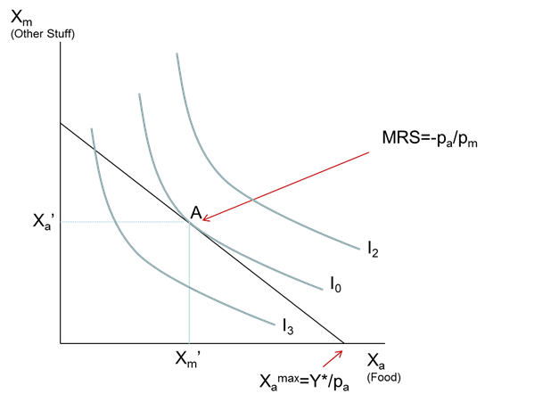
It’s a Household, So Start with Consumer Theory

Slide 13
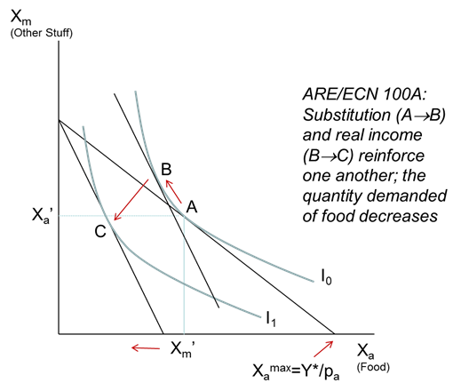
What Happens When the Price of Food Goes Up?

Slide 14
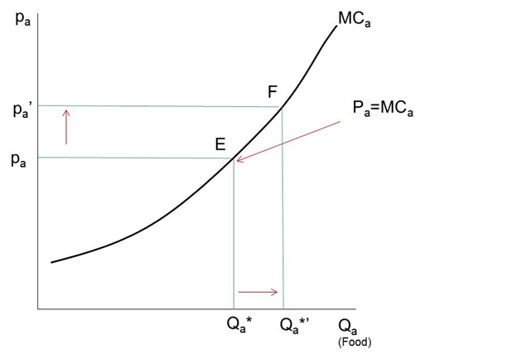
But the Farm Household is a Producer, too!
Farm Profits Go Up!

Slide 15
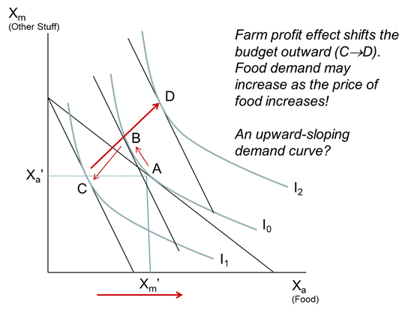
The Profit Effect Shifts the Budget Constraint Outward

Slide 16
Is the Agricultural Household Better Off When Food Prices Rise?
It depends…
  The household gains as a producer
  …but it loses as a consumer
A big surplus-producer benefits most
A net buyer loses

Slide 17
The Big Lessons from Agricultural Household Models
If a government wants to increase the supply of food for its urban consumers, raising the price of food will not necessarily help
  It depends on the marketed surplus effect
If the price of food goes up, it can be bad news not only for urban consumers but also small farmers
  Chris Barrett found most small farm households are net buyers of food

Slide 18
How Do We Know Whether Higher Food Prices Help Rural Households?
The Net Benefit Ratio (Amartya Sen):

Slide 19
Measuring Welfare Effects:
The Net Benefit Ratio (NBR)
Angus Deaton
Ratio of net agricultural sales (MS) to total income (or expenditures, E)
E.g.: A household produces $250 and consumes $50. Its total income is $500. The NBR = (250-50)/500=.4
A 1% increase in output price raises welfare by 0.4%
A negative NBR tells us the household is worse off if the crop price goes up (true for all non-agricultural and most agricultural households)

Slide 20
Everything Depends on the Supply Response
Many things can constrain the supply response (i.e., make the supply curve vertical), especially on small farms
  Limited access to land, and especially irrigated land
  Poor land quality
  Technological limitations, including lack of access to high-productivity seeds
  Limited access to modern inputs, like fertilizer
  A lack of cash to purchase inputs, and limited or no access to credit
  Limited or no access to insurance to protect against crop failure
  Labor constraints

Slide 21
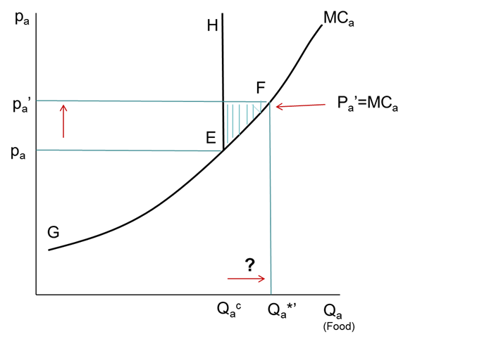
How Constraints can “Kink” the Supply Curve
Constraints “bind” at Q_{a}^{c}

Slide 22
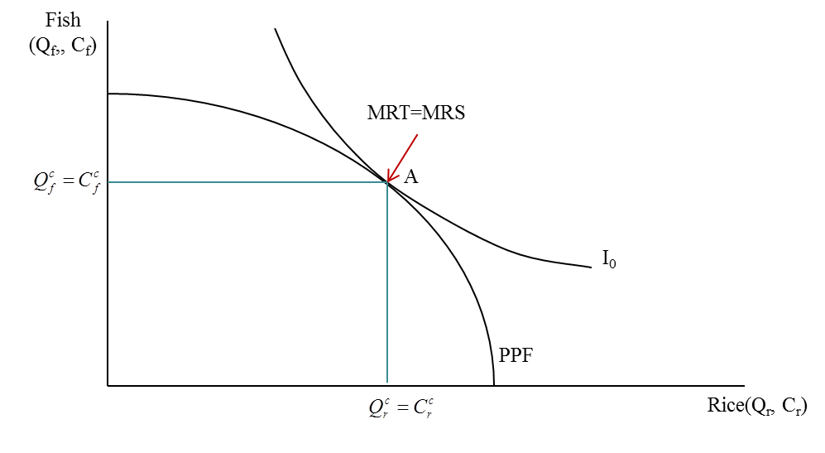
The Subsistence Household
Where are the prices? (Answer: they’re “shadow prices,” not market prices.)
Notice the household’s budget constraint is now the PPF!
PPF: Production Possibility Frontier (why not a straight line?)

Slide 23
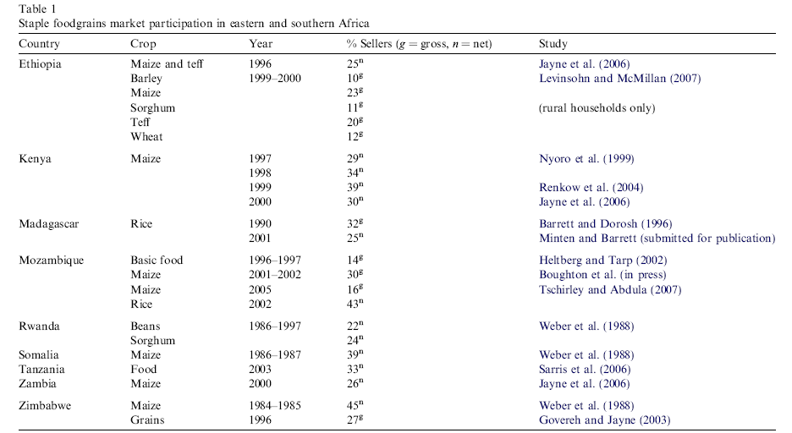
Most Staple Producers in Eastern and Southern Africa Aren’t in the Market
Source: Barrett, Food Policy, 2008

Slide 24
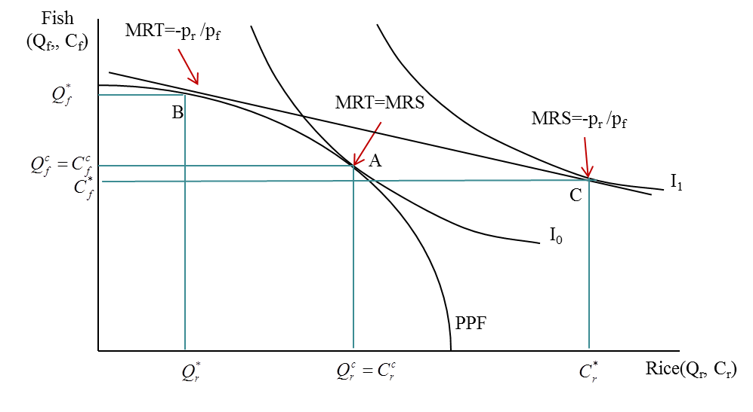
…Gains from Trade

Slide 25
Food Security vs. Self-sufficiency
Food security: securing year-round access to an adequate supply of nutritious and safe food to meet the dietary needs of all members of the household
  Can be either through own production or purchases (Callens and Seifert, 2003)
  I’m food secure but certainly not self-sufficient!

Slide 26
Production and Consumption, Normal Year, With Markets
Fish
(Q_{f},C_{f})
- p_{r} /p_{f}
Marketed Surplus
B
C
Ι₁
A
PPF
Purchases
Rice
(Q_{r}, C_{r})

Slide 27
Production and Consumption, Drought Year, With Markets
Fish
(Q_{f},C_{f})
B’
- p_{r} /p_{f}
Marketed Surplus
C’
Ι₁’
A
PPF
Purchases
Rice
(Q_{r}, C_{r})

Slide 28
Production and Consumption, Rice Collapse, With Markets
Fish
(Q_{f},C_{f})
B’
- p_{r} /p_{f}
Marketed Surplus
C’
Ι₁’
Purchases
Rice
(Q_{r}, C_{r})

Slide 29
Production and Consumption, Normal Year, Without Markets
Fish
(Q_{f},C_{f})
A
Ι₀
- ρ_{r} / ρ_{f}
PPF
Rice
(Q_{r}, C_{r})

Slide 30
Production and Consumption, Drought Year, Without Markets
Fish
(Q_{f},C_{f})
A’
Ι₀’
PPF’
Rice
(Q_{r}, C_{r})

Slide 31
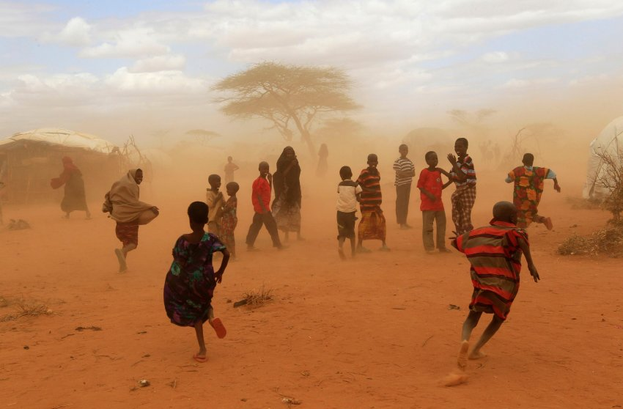

Production and Consumption, Rice Collapse, Without Markets
Fish
(Q_{f},C_{f})
A’
Ι₀’
Rice
(Q_{r}, C_{r})

Slide 32
Conflict within the Household?
Does it make sense to have a household utility function?
  Or is the household a collection of individuals each with his/her own preferences and resources?
  Are the interests of different household members compatible?
  In a cash transfer program, does it matter whom you hand the money to?

Slide 33
Nash-bargained Households
(John Nash, as in The Beautiful Mind)
Consider two people, persons m and f
Let:
  v_{m} be m’s utility or welfare if they do not form a household, and let v_{f} be person f’s.
  If they form a household, they’ll combine their income and spend it on things either or both care about.
    Person m’s welfare will be U_{m} and f’s will be U_{f}

Slide 34
Marriage and Threat Points
Neither one will want to form a household unless there’s a positive welfare gain in it
    So both U_{m} - v_{m} and U_{f} – v_{f} must be positive
Once the household gets formed:
  The hh utility funciton is: U=(U_{m} - v_{m})(U_{f} – v_{f} )
  v_{m} and v_{f} are “threat points”
    The utilities the two people would have in the “game” of being single.
    The higher a person’s threat point, the more bargaining power s/he has in the Nash-bargained household.

Slide 35
Income and Assets Raise the Threat Point
Who controls the cash significantly explains household expenditures (boxes)
  A rupee is not a rupee
  If you want more spending on nutrition, health, education, give cash to women
  Chris Udry: Female plots get less fertilizer than male plots
    Households could be better off by shifting inputs from male to female plots—but they don’t

Slide 36
Beyond Households http://www.youtube.com/watch?v=j-zczJXSxnw
Linkages among households shape impacts of development projects and other shocks
  Like ripples in a pond
General-equilibrium (GE) effects
Box: subsistence households aren’t isolated from food price shocks!

Slide 37








Policy or Market Change

Slide 38
Policy or Market Change
They adjust…

Slide 39
Policy or Market Change
Farm-nonfarm linkages
They affect others…

Slide 40
Policy or Market Change
Farm-nonfarm linkages
…who adjust

Slide 41
Policy or Market Change
Farm-nonfarm linkages
…and affect still others

Slide 42
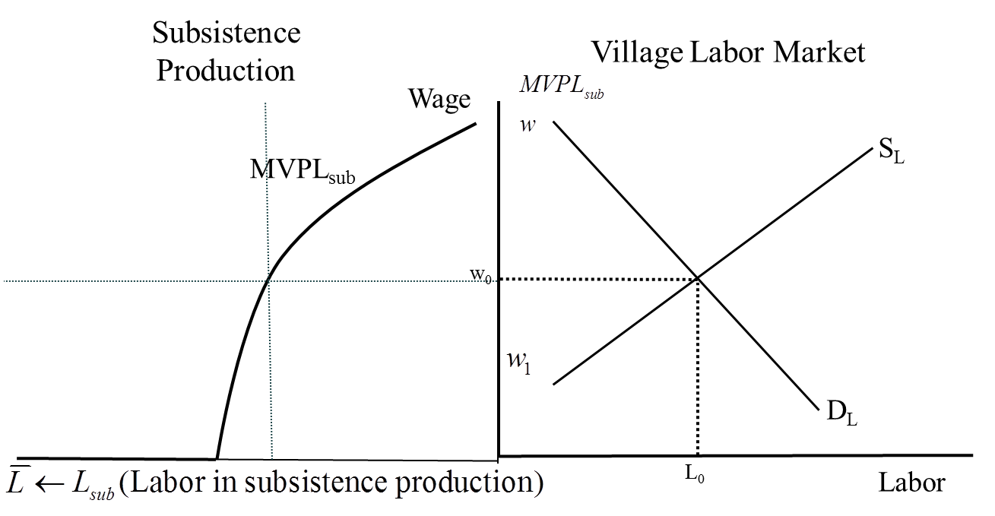
Subsistence Response to Market Shocks (Box)

Slide 43
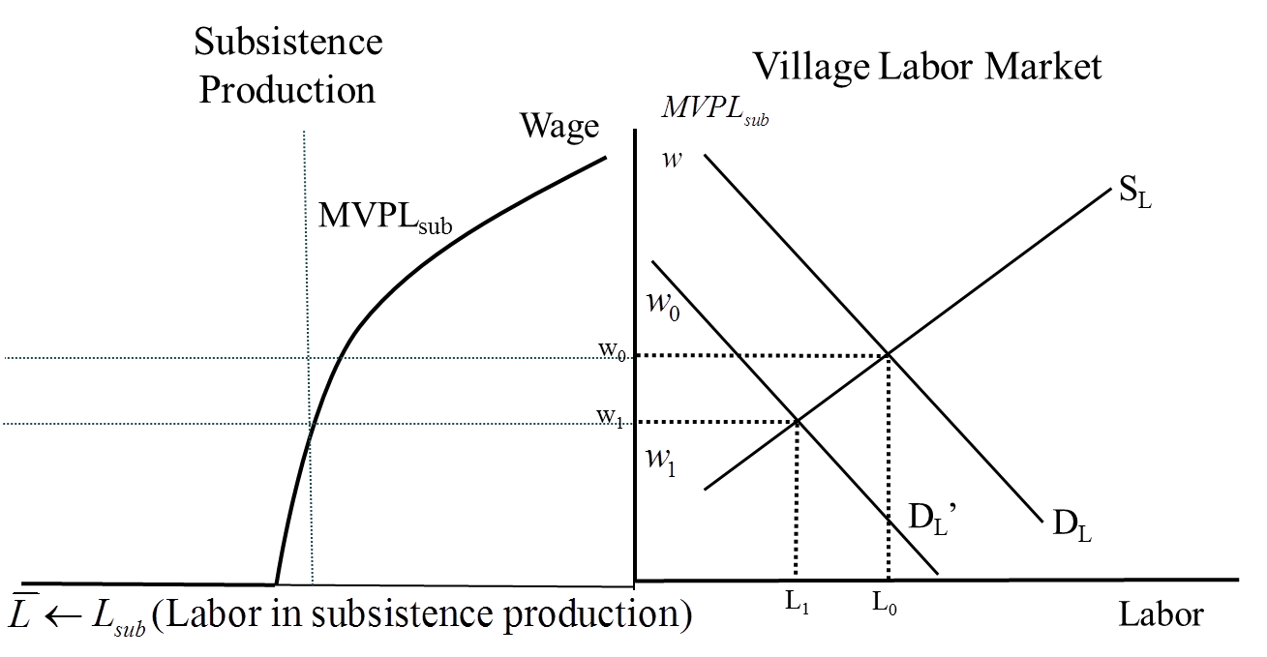
Subsistence Response to Market Shocks (Box)

